Slide 1
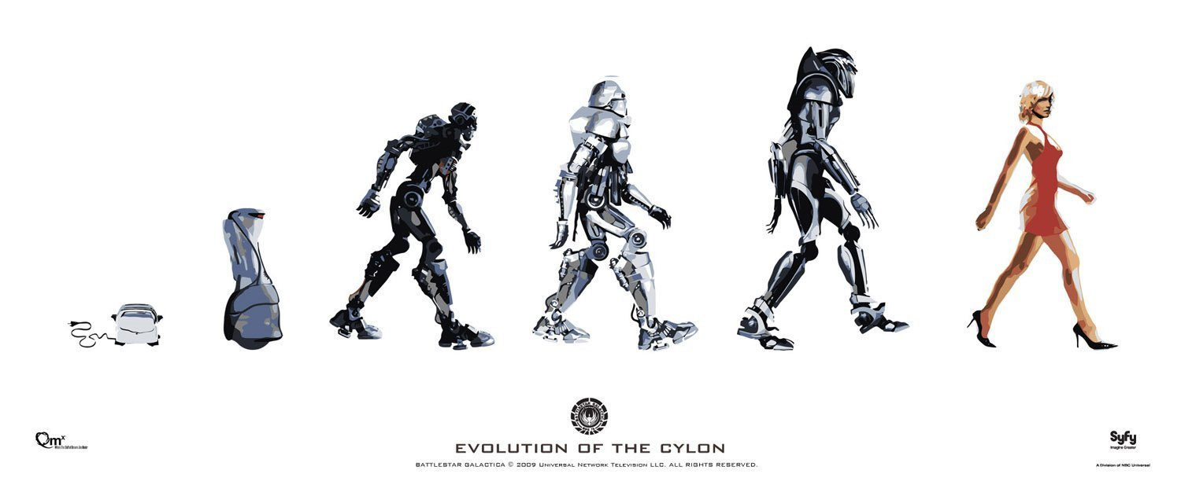
Robot Apocalypse
battlestar
Will the machines rise up against us? What is human destiny?
Notes:
http://static.dramastyle.com/images/1/5/1278/Battlestar-Galactica__184.jpg

Slide 2
What is the most impressive technology?
3D printing
AI
Robots
Medical Advancements
The Printing Press
Cancer vaccines
DNA & Genetics
Airplanes
Space Travel
Movies & Media
The Internet
Communications/Satellites
Drones
Wearable technology
A head transplant
Notes:
Cybernetics is relevant to the study of systems, such as mechanical, physical, biological, cognitive, and social systems

Slide 3
Can the Singularity happen?
Can machines become sentient or conscious?
Will the machines rise up against us?
Or is it all just Hollywood woo?
Notes:
https://www.youtube.com/watch?v=LjWc2vtbn9M
We've all heard the failed predictions of Scifi. Where are our flying cars?
the singularity: a tipping point, where the accelerating pace of smarter and smarter machines will soon outrun all human capabilities
"Moore's law" is the observation that, over the history of computing hardware, the number of transistors in a dense integrated circuit doubles approximately every two years. The observation is named after Gordon E. Moore, co-founder of the Intel Corporation, who first described the trend in a 1965 paper^{[1][2][2][3]}
Can machines become conscious? Can machines rise up? Let's predict the future... Would movies or TV ever exaggerate something?

Slide 4

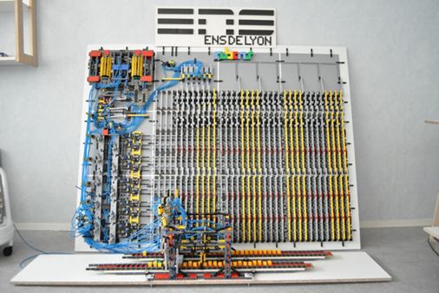
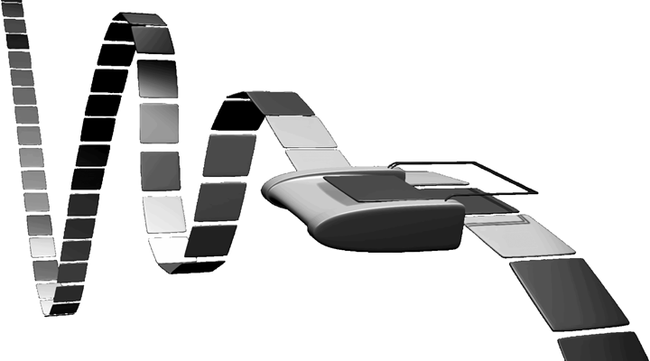
In the beginning...
Notes:
The "machine" was invented in 1936 by Alan Turing^{[1]} ^{[2]} who called it an "a-machine" (automatic machine). The Turing machine is not intended as practical computing technology, but rather as a hypothetical device representing a computing machine. Turing machines help computer scientists understand the limits of mechanical computation.

Slide 5
What is Artificial Intelligence?
What exactly is intelligence?
What is artificial?

Slide 6
Two AI Problems
Easy:
Mimicking human behaviors,
computations
Hard:
Understanding the world, subjective experiences, sentience, consciousness, qualia

Slide 7
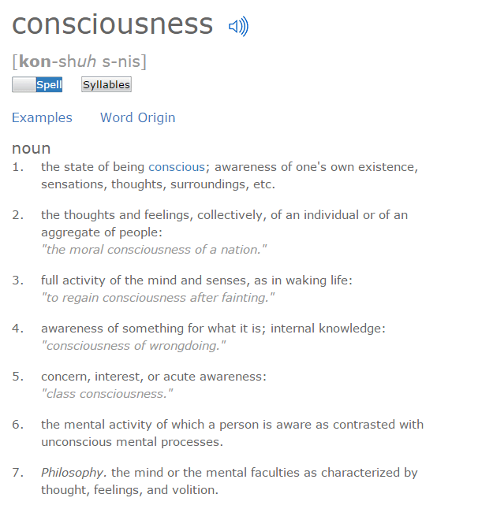
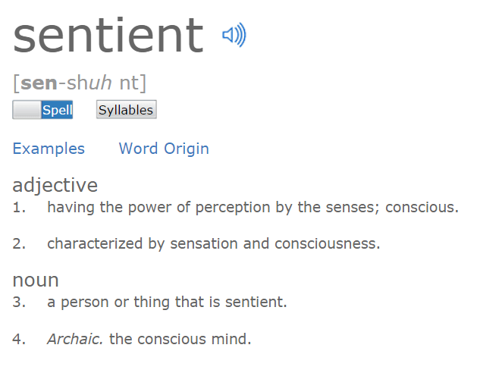
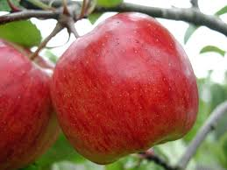
Consciousness:
How the camera sees the apple vs how a human does. The human can make sense of it, the camera can not.
Notes:
And to what degree....we can make bug bots that work at the same level of consciousness as an insect

Slide 8
AI
Artificial Consciousness (http://en.wikipedia.org/wiki/Artificial_consciousness)
Awareness
Anticipation
Subjective Experience
Learning
A Computational Foundation for the Study of Cognition by David Chalmers
computers that perform computations and the right kinds of computations are sufficient for the possession of a conscious mind.
Notes:
http://en.wikipedia.org/wiki/Artificial_consciousness
http://consc.net/papers/computation.html
computers perform computations and the right kinds of computations are sufficient for the possession of a conscious mind.

Slide 9
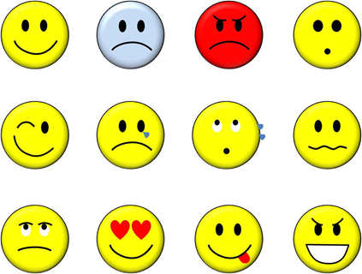
AI Considerations
Intelligence,
free will,
memories, learning,
consciousness, qualia,
beliefs, biases
irony, humor
morals
Pattern Matching
Emotions
Self Preservation
Reality Detection
Robots cannot anticipate the future
Notes:
Memories for us aren't like a tape recorder
Michio Kaku discusses these in his book, The Future of the Mind.
Robots can do chess as there are a limited but large number of moves to catalog. they do not make on the fly decisions like we do

Slide 10
AI: I learned it from that movie

Slide 11
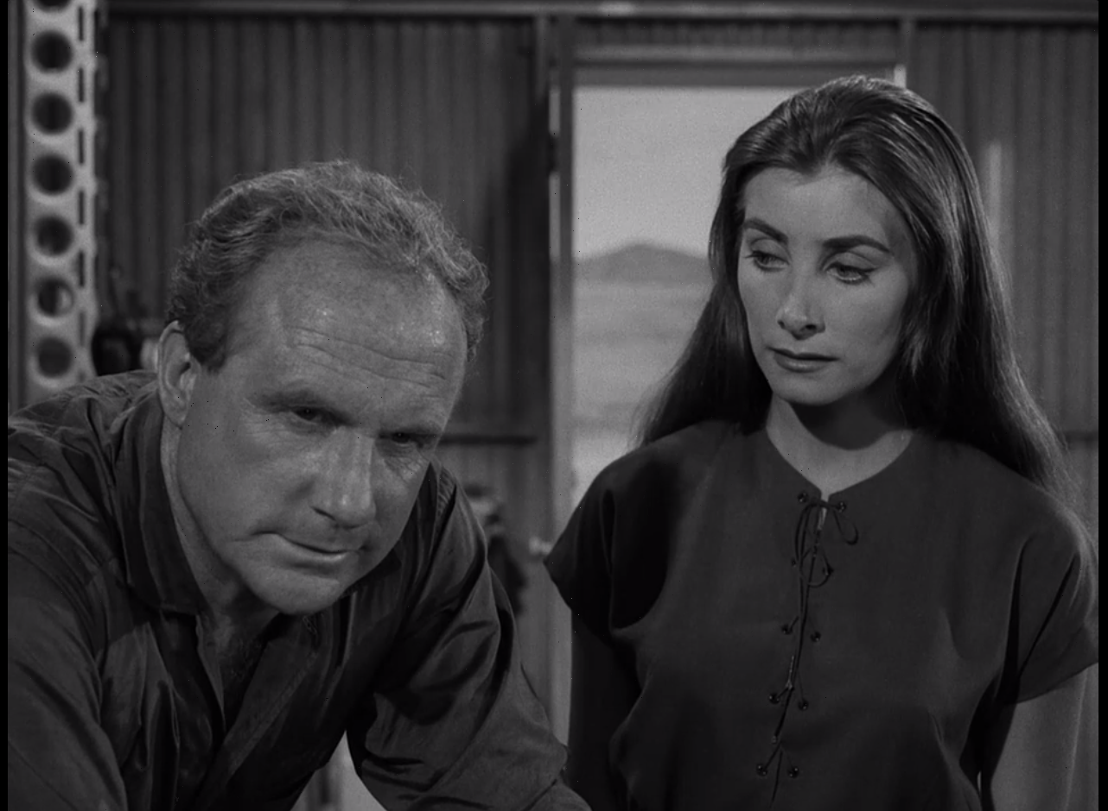
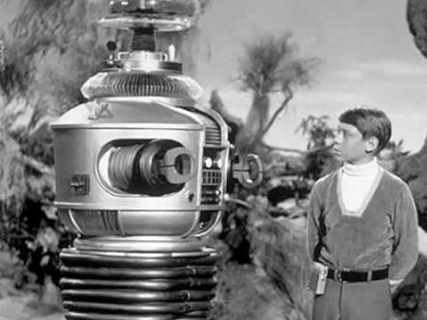
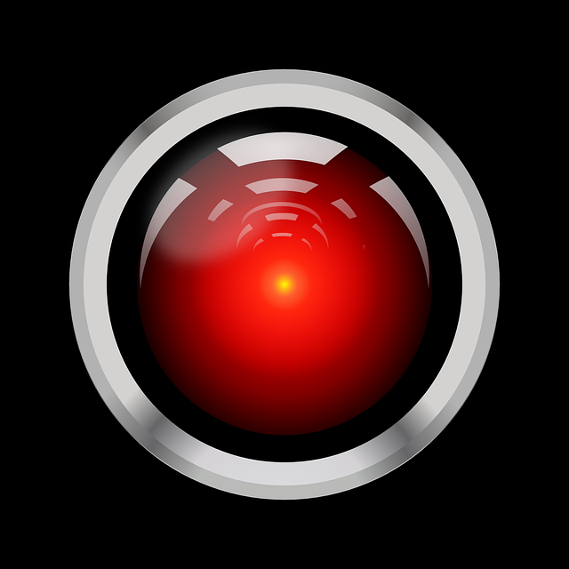
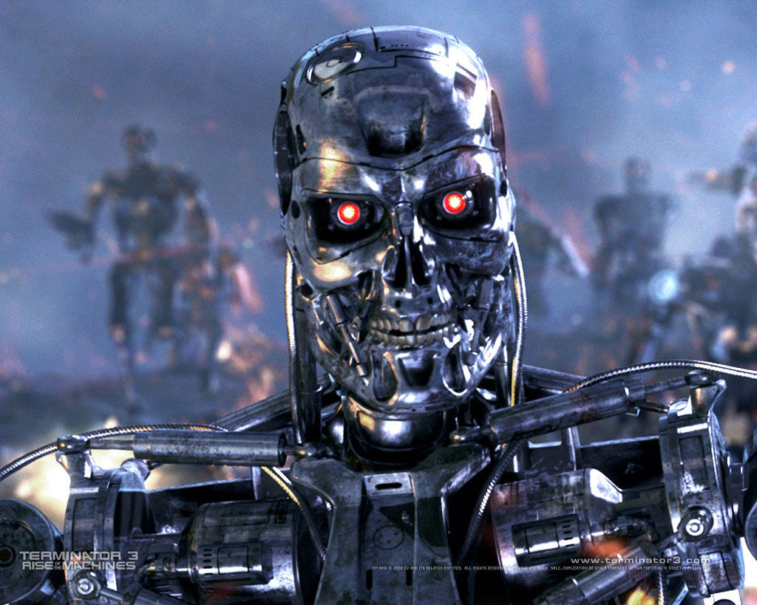
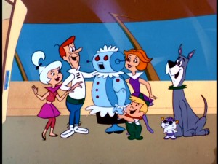
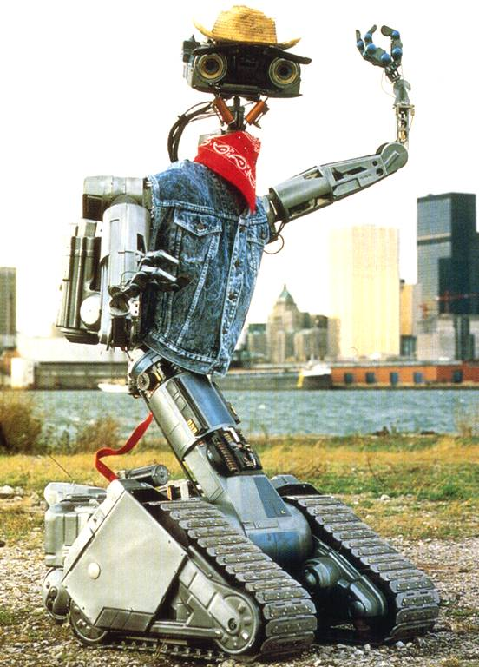
Notes:
Twilight zone 1958
Lost In Space 1965
Terminator 1984
Short Circuit 1986

Slide 12
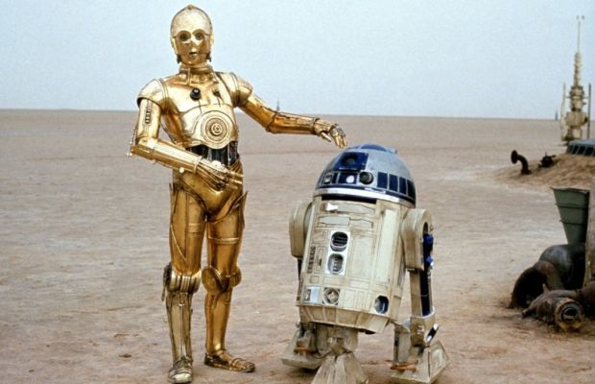
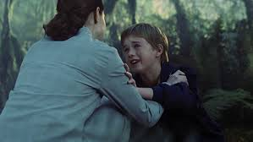
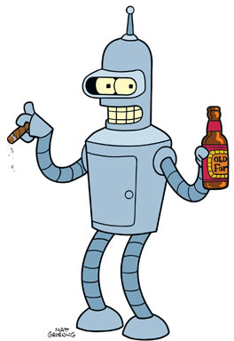
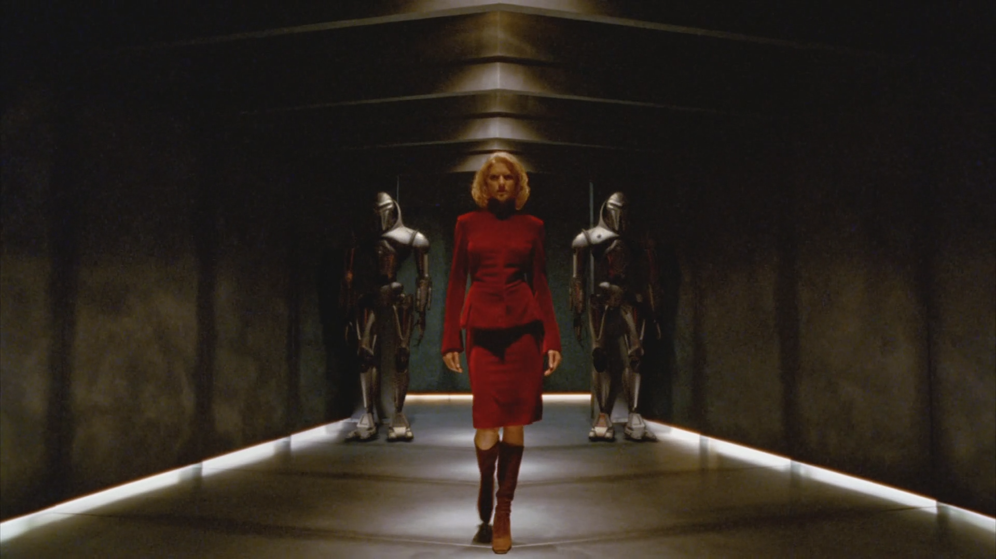
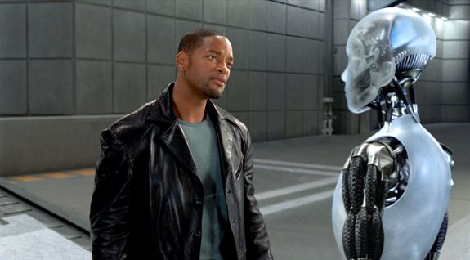
Notes:
Twilight zone episode in which the prisoner falls in love with a robot companion
forget about how much it costs to ship supplies up there 2x a year and the other ridiculous logistics
Corry and Alicia the robot.
In "The Lonely", Episode 7 of The Twilight Zone, James Corry falls in love with his robot companion, Alicia. He even ends up killing over her.

Slide 13
AI & Robots Today Reality

Slide 14
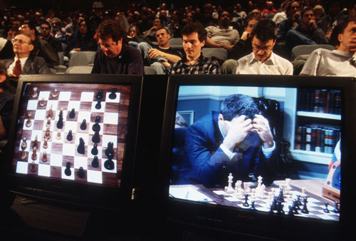
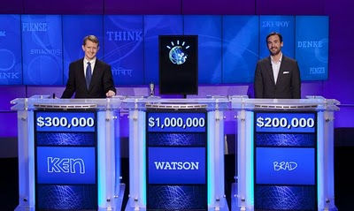
AI Today
Translators/language
Customer Service bots
Facebook
Hospitals
Transportation
Marketing
Fraud detection
Machine learning
Military
Notes:
Deep blue vs Gary Kasparov 1996 4-2 he also lost again in1997
deep blue – it learns, but not without a human giving it more input. it's not autonomous
the car - it reacts to events, but does not collect that as an experience to learn from
google car – just now

Slide 15

AI Today
Target's AI
Dad speaks to manager at Target:
“My daughter got this in the mail!” he said. “She’s still in high school, and you’re sending her coupons for baby clothes and cribs? Are you trying to encourage her to get pregnant?”
In a later phone conversation with manager:
“I had a talk with my daughter,” he said. “It turns out there’s been some activities in my house I haven’t been completely aware of. She’s due in August. I owe you an apology.
Notes:
http://www.forbes.com/fdc/welcome_mjx.shtml
how target knew:
"Pole] ran test after test, analyzing the data, and before long some useful patterns emerged. Lotions, for example. Lots of people buy lotion, but one of Pole’s colleagues noticed that women on the baby registry were buying larger quantities of unscented lotion around the beginning of their second trimester. Another analyst noted that sometime in the first 20 weeks, pregnant women loaded up on supplements like calcium, magnesium and zinc. Many shoppers purchase soap and cotton balls, but when someone suddenly starts buying lots of scent-free soap and extra-big bags of cotton balls, in addition to hand sanitizers and washcloths, it signals they could be getting close to their delivery date."
the story:
“My daughter got this in the mail!” he said. “She’s still in high school, and you’re sending her coupons for baby clothes and cribs? Are you trying to encourage her to get pregnant?”
The manager didn’t have any idea what the man was talking about. He looked at the mailer. Sure enough, it was addressed to the man’s daughter and contained advertisements for maternity clothing, nursery furniture and pictures of smiling infants. The manager apologized and then called a few days later to apologize again.
On the phone, though, the father was somewhat abashed. “I had a talk with my daughter,” he said. “It turns out there’s been some activities in my house I haven’t been completely aware of. She’s due in August. I owe you an apology.

Slide 16
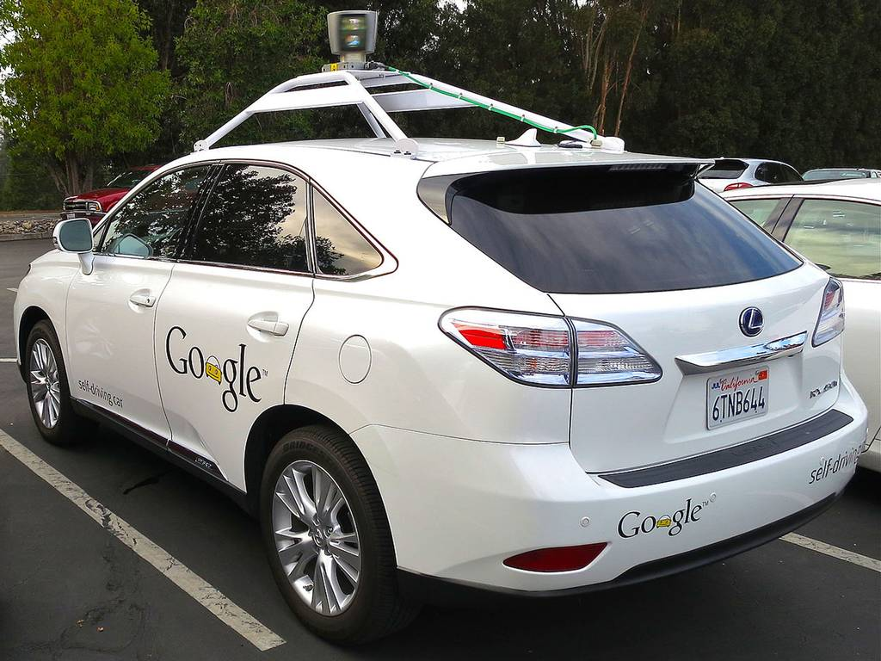
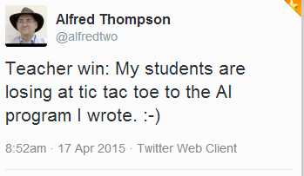
AI Today
In 2013, the NY Times said that AI is moving at such a rate as to be "magical"
cleverbot.com
elbot.com
Google also created AI that can learn
Notes:
The NY Times in 2013 said that AI is moving at such a rate as to be magical
http://www.nytimes.com/2013/10/15/technology/the-rapid-advance-of-artificial-intelligence.html?pagewanted=all
It has been two years since Watson, the artificial intelligence program created by I.B.M., beat two of the world’s best “Jeopardy” players. Watson, which has access to roughly 200 million pages of information, is able to understand natural language queries and answer questions.
The computer maker had initially planned to test the system as an expert adviser to doctors; the idea was that Watson’s encyclopedic knowledge of medical conditions could aid a human expert in diagnosing illnesses, as well as contributing computer expertise elsewhere in medicine.
In May, however, I.B.M. went a significant step farther by announcing a general-purpose version of its software, the “I.B.M. Watson Engagement Advisor.” The idea is to make the company’s question-answering system available in a wide range of call center, technical support and telephone sales applications. The company says that as many as 61 percent of all telephone support calls currently fail because human support-center employees are unable to give people correct or complete information.
omputers that understand our deepest emotions hold the promise of a world full of brilliant machines. They also raise the specter of an invasion of privacy on a scale not previously possible, as they move a step beyond recognizing human faces to the ability to watch the array of muscles in the face and decode the thousands of possible movements into an understanding of what people are thinking and feeling.

Slide 17
Just say no…..to humans
https://www.inverse.com/article/8400-this-robot-has-learned-how-to-say-no-to-human-demands

Slide 18
What is Robotics?
Remote controlled machines
Semi autonomous machines that require human input
Fully autonomous machines
Notes:
Terminator: fully autonomous killing machine

Slide 19
Classic Problems in robotics
Being able to navigate the world as well as a toddler
Discerning meaning from imagery
Learning how to learn, and then learning
Working in the same way thought works
Notes:
Pinker says thought is formed by our language

Slide 20
It can't do much without a brain

Slide 21
How Does the Brain Work?
Memory isn't like a video tape
Neural network
Notes:
Marvin Minsky say you're thinking about the brain wrong.
Rather than trying to understand it by understanding the parts work and how the parts interconnect and work isn't the way
It's like trying to understand how a computer works by learning about how the transistors work and never turning on a machine to see the product of software
So we must understand the brain by thinking about how thinking works.

Slide 22
What does the brain do?
Low order functions
Heart, breathing, perspiration, thyroid/glandular, temperature
Instincts, mental states, flight/fight response
Senses: touch, smell, taste, sight
Subconscious
High order
Accessing memories
Doing math, crafts, arts, sciences, music
Socializing
Listening to this talk
Walking, navigating
Conscious

Slide 23
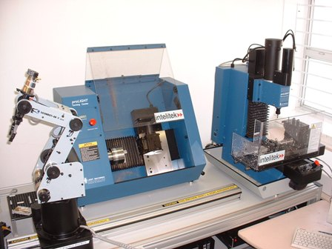
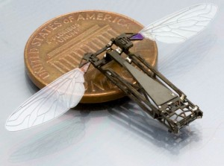
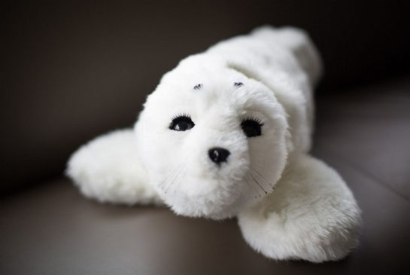
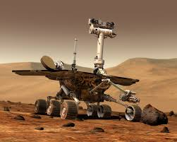
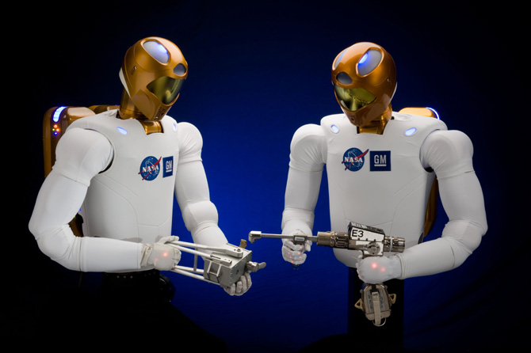
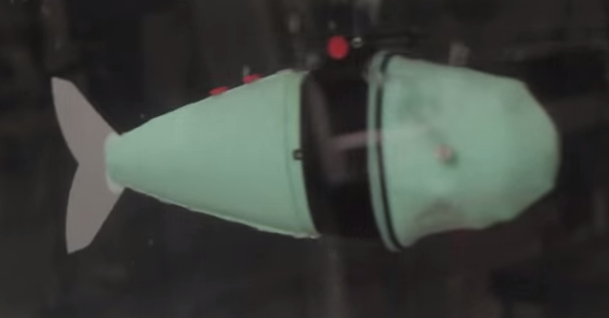
Robots Today
Notes:
Troody the raptor robot https://www.youtube.com/watch?v=tOp1DX4De0g

Slide 24
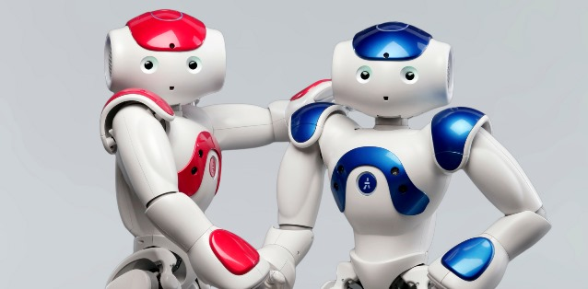
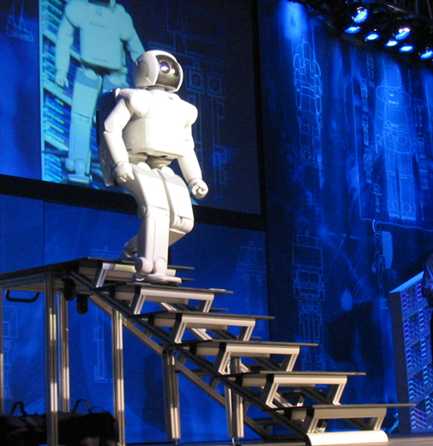
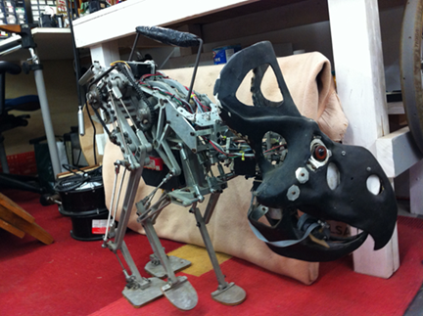
Robots Today
Notes:
the Nao robot by Aldebaran https://www.youtube.com/watch?v=nNbj2G3GmAo nao is autonomous
Dancing NAO http://www.nytimes.com/2015/04/21/science/smart-arms-control-the-potential-chaos-of-octopus-movement.html?smid=tw-share&_r=0
asimo is not autonomous. only has a few aut functions

Slide 25

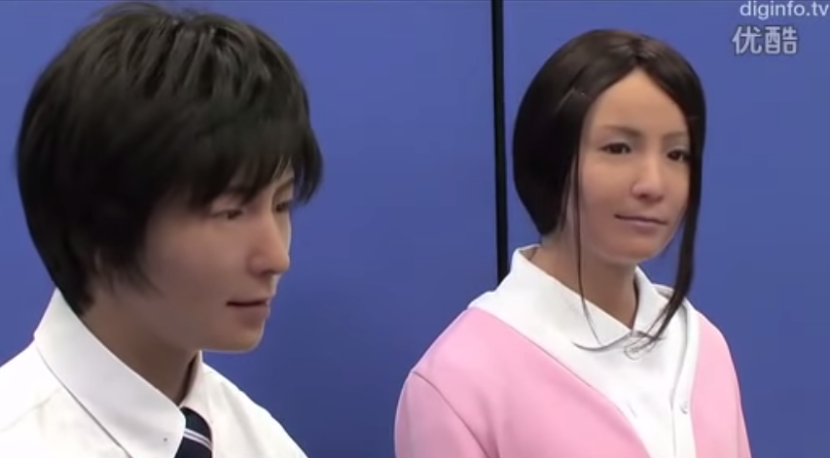
Robots Today
There is no mistaking a robot for a human.
or is there?

Slide 26
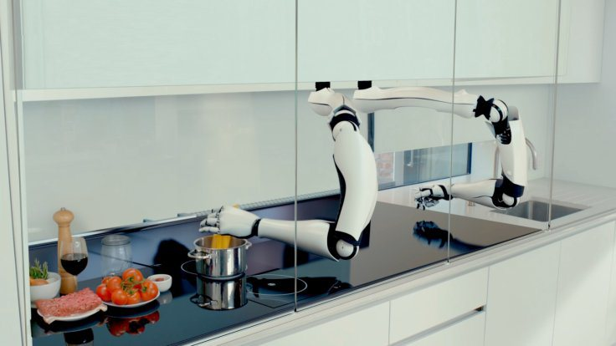
Robots Today
New Japanese hotel nearly fully staffed with robots
Robot chefs
Notes:
http://www.livescience.com/49711-japanese-robot-hotel.html

Slide 27
Robots Today
https://www.youtube.com/watch?v=0jXI5p3zSZI
mini swarm robots http://lmoroney.blogspot.com/2015/04/swarms-of-miniature-robots.html
https://www.youtube.com/watch?v=6feEE716UEk
nexi https://www.youtube.com/watch?v=aQS2zxmrrrA
robot learns like toddler https://www.youtube.com/watch?v=U-FOr7hEw1c
spot boston dyn https://www.youtube.com/watch?v=M8YjvHYbZ9w
Atlas boston dyn https://www.youtube.com/watch?v=rVlhMGQgDkY
2.15 on boston dynamics spot
https://www.youtube.com/watch?v=QVdQM47Av20
very human looking robots https://www.youtube.com/watch?v=MaTfzYDZG8c
NAO & Pepper robots
https://www.youtube.com/watch?v=nNbj2G3GmAo
http://www.jibo.com
Notes:
Japanese
https://www.youtube.com/watch?v=MaTfzYDZG8c
this one named Philip Dick is very humanoid. named after the blade runner author
https://www.youtube.com/watch?v=YUvDBGYk17Y
---
miya from japan very lifelike https://www.youtube.com/watch?v=eEzH40l-Dg8
CREEPY ASS baby robot http://www.huffingtonpost.com/2012/01/30/robots-creepy_n_1242603.html? (about 6 in)
http://www.ibtimes.co.uk/human-machine-life-like-android-robots-japan-show-glimpses-future-1453992

Slide 28
In the near future... Robots will take our jobs
Pharmacists
Drivers
Store Clerks
Soldiers
Marketing
Programming
Forbes predicts 45%
Notes:
http://www.forbes.com/sites/timworstall/2013/09/18/phew-the-robots-are-only-going-to-take-45-percent-of-all-the-jobs/

Slide 29
Moore's Law
Computing power doubles approximately every two years.

Slide 30
Even if they're not conscious
We can live and work with them, but
can we come to love machines, the way we love humans?

Slide 31
A self aware robot?
Niko passes the mirror test
Robots that watch other robots and learn
Notes:
https://www.youtube.com/watch?v=tOp1DX4De0g

Slide 32
Great Minds
Ray Kurzweil, Michio Kaku, Stephen Hawking, Steven Pinker, Marvin Minsky, and many other prominent scientists have warned humans that a Singularity can occur and we should be prepared.

Slide 33
Stanford CompSci professor Eric Roberts believes we have cause to believe we can simulate the brain's processing power in a few years. After that, we will be downloading consciousness.
Notes:
http://cs.stanford.edu/people/eroberts/cs181/projects/2010-11/DownloadingConsciousness/tandr.html

Slide 34
Science Today
Thought controlled genes
We can read thoughts in animals
Brain cells on microchips
Microchips on brain cells
Liquid, shape-shifting metals
We can scan food and materials at the molecular level like on Star Trek
Notes:
http://www.scientificamerican.com/article/thought-controlled-genes-could-someday-help-us-heal/?WT.mc_id=SA_Facebook
http://www.cnn.com/videos/tech/2015/03/02/erin-dnt-burnett-scio-calorie-scanning-technology.cnn
http://www.dailymail.co.uk/sciencetech/article-2766678/Rise-Terminator-Scientists-create-shape-shifting-liquid-metal-used-heal-human-body.html/video/playlists/the-world-of-technology/

Slide 35
Science Today
Direct brain to brain communications
Non-Invasive Brain-to-Brain Interface (BBI): Establishing Functional Links between Two Brains
Think about Cylons
Cognitive Computing systems
Bioengineered and plastic blood is a thing
Most hormones are available in artificial form
3D printed molecules and organs
Notes:
Direct brain to brain communications http://www.huffingtonpost.com/2014/11/08/brain-interface_n_6115334.html 94% success rate
Non-Invasive Brain-to-Brain Interface (BBI): Establishing Functional Links between Two Brains http://journals.plos.org/plosone/article?id=10.1371/journal.pone.0060410
human brain to brain http://www.bbc.com/news/business-23994649
Simulating 1 second of human brain activity takes 82,944 processors according to NEST http://www.extremetech.com/extreme/163051-simulating-1-second-of-human-brain-activity-takes-82944-processors see also http://io9.com/this-computer-took-40-minutes-to-simulate-one-second-of-1043288954
bio blood http://www.scientificamerican.com/article/first-bioengineered-blood/
Consciousness on/off switch is found http://io9.com/scientists-accidentally-discover-the-brains-consciousne-1600230950
Cognitive Computing systems
http://www.research.ibm.com/cognitive-computing/#fbid=iNYWxx9riaf
Simulating 1 second of human brain activity takes 82,944 processors
A good analogy of consciousness is explained here based on work by Giulio Tononi. Imagine the difference between the image of an apple to your brain and a digital camera. The raw image is the same whether on a camera screen or in your head. The camera treats each pixel independently and doesn’t recognise an object. Your brain, however, will combine parts of the image to identify an object, that it is an apple and that it is food. Here, the camera can be seen as ‘unconscious’ and the brain as ‘conscious’.

Slide 36
Robotic-human enhancements
Nanotechnology
Dental, Prosthetics & Exoskeletons
Artificial blood (plastic)
The Argus II Bionic eye
The Transcriptor, a biological computing device
lives inside cells
Notes:
http://www.livescience.com/1522-plastic-blood-save-lives.html
The “Argus II” takes a video signal from a camera built into sunglasses and wirelessly transmits that image to implants in the retinas of people who have lost their vision. Though it’s been available in Europe since 2011, the U.S. Food and Drug Administration (FDA) only approved the eye earlier this year. “This really is like Star Trek technology,” Dr. Roizen says.
Using only biomolecules (such as DNA and enzymes), scientists at the Technion-Israel Institute of Technology have developed and constructed an advanced biological transducer, a computing machine capable of manipulating genetic codes, and using the output as new input for subsequent computations. The breakthrough might someday create new possibilities in biotechnology, including individual gene therapy and cloning.
http://www.sciencedaily.com/releases/2013/05/130523180318.htm
http://www.extremetech.com/extreme/152074-stanford-creates-biological-transistors-the-final-step-towards-computers-inside-living-cells

Slide 37
Robot Utopia
Nobody needs to work.
Everybody is healthy and wealthy while robots drive us around, wait on us, act as our physicians, etc..
Then humans have nearly 100% free time for art, advancement of science, entertainment, etc...
though robots will do art, science and entertainment too

Slide 38
Robots of the Future
Cylon style robots
Organic, free-range, robots
Blended Humanoid-Robot beings
Notes:
http://techcrunch.com/2015/03/23/plen2/

Slide 39

Thought experiment
Suppose surgeons replaced one of your hundred billion neurons with a microchip.
Presumably you would feel and behave exactly as before.
Then they replace a second one, and a third one, and so on, until more
and more of your brain becomes silicon.
The chips do what the neurons did, so your behavior and memory never change.
Are you still human?
At which point are you not?
Notes:
steven pinker asked this in http://pinker.wjh.harvard.edu/articles/media/1997_08_18_usnewsworldreport.html
Suppose surgeons replaced one of your hundred billion neurons with a microchip.
Presumably you would feel and behave exactly as before.
Then they replace a second one, and a third one, and so on, until more
and more of your brain becomes silicon.
The chips do what the neurons did, so your behavior and memory never change.
(You could use the example of every cell in your entire body also instead of this one)
Are you still human at the end? If not, at which point are you not?

Slide 40
If we start with Artificial Intelligence...
+Robotics
+Brain/cognitive sciences
+Genetics engineering
+Shape shifting metals
+Organs grown in the lab
+Brain cells on computer chips
+Computer chips inside cells
+Nanotechnology
+The Internet and the Cloud
+Organic computing
+Bionics

Slide 41
Sum those technologies, then consider the volumes of time, people, and money that goes into these sciences. And Moore's Law.
Often they are fueled by art and imagination.
Then mix in the desire for humans to live a long life, and to maximize our health, well being while, and ability while we're here.
What could possibly go wrong?

Slide 42
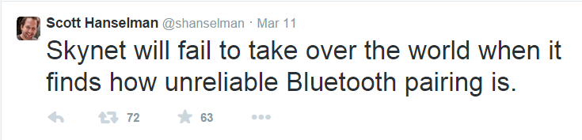

Slide 43
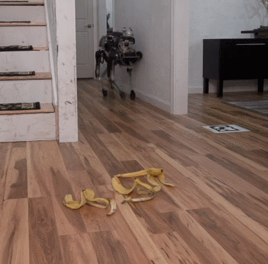

Slide 44
What is our destiny?
The sum of our hopes, dreams, and imagination that is realized by scientific achievement.

Slide 45
What is our destiny?
Hollywood would like us to think...
Cylons evolved to be more human, then rose up against us
AI scientists would like us to think...
We will evolve to become more and more machine, possibly even living in a virtual and immortal world.
Notes:
We are worried about creating machines that will rise up
are machines asking if we will rise up?

Slide 46

I, for one, welcome our new robot overlords.

